Slide 1
VANDE BHARAT TRAIN ANALYSIS
POWER BI DASHBOARD PRESENTATION BY
WAFA SHAKKIR

Slide 2
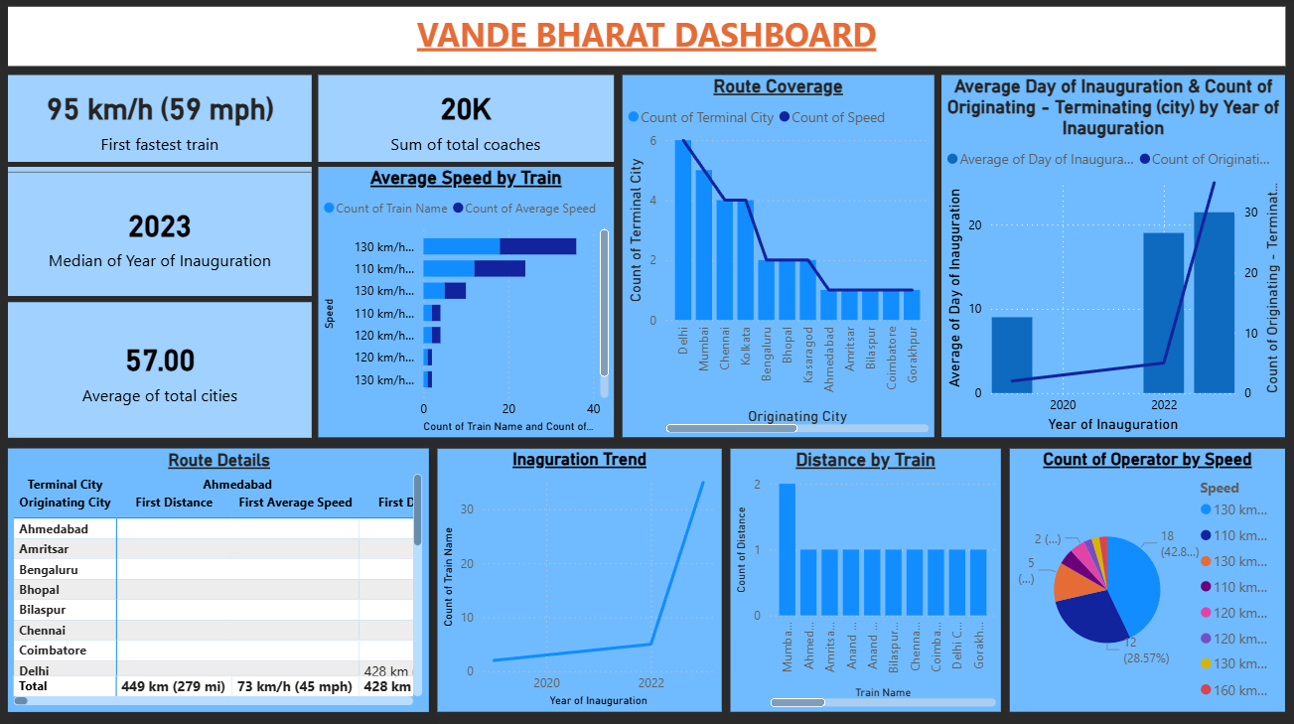

Slide 3
KPIs
Fastest train
Total coaches
Median of year of inauguration
Average of total cities

Slide 4
Dashboard Visualizations
• Average Speed by Train (Bar Chart)
• Distance by Train (Column Chart)
• Route Coverage (Line & Column Chart)
• Inauguration Trend (Line Chart)
• Speed Distribution (Pie Chart)
• Route Details (Table)
•Average Day of Inauguration & Count of Originating-Terminating (City) by Year of Inauguration (Line & Stacked Column Chart)

